Slide 1
Rock, Paper, Scissors Machine Learning Application
CMPE 255 Data Mining
Professor Sithu Aung
Krishna Priya Gajula
Brian Hoang
Anjani Mallampati
Archana Yadawa

Slide 2
Introduction
Rock, Paper, Scissors application utilizes both hardware and software components to capture/predict responses for a typical game
Notes:
Our topic is a rock paper scissors application that predicts whether the hardware glove is showing rock paper or scissors. This application consists of both hardware and software parts

Slide 3
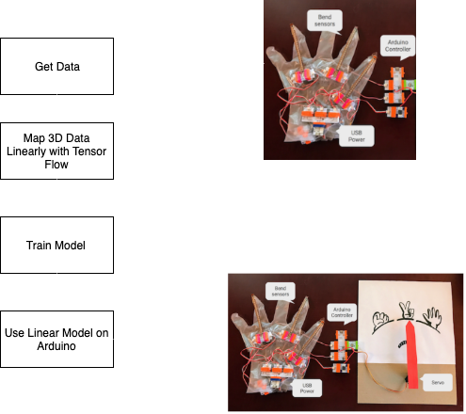
High Level Diagram
Notes:
Original dataset captured using Arduino board with sensor peripheries.
Different game selections monitored in relation to combinations of ‘finger bends’, captured by associated Arduino sensors.
Removes need for hardcoded ‘if’ statements to determine which category set of sensor data falls under.
TensorFlow used to draw patterns with connected data and determine various weights of importance for various finger sensors in overall solution. Is used to derive the linear equation used to map sensor data.

Slide 4
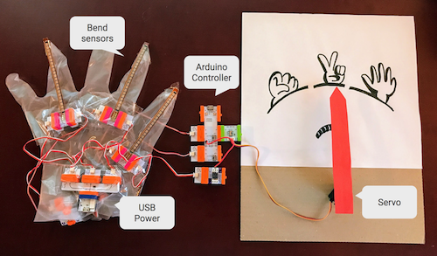
Hardware Setup 1
Overall hardware
Notes:
Arduino consists of both a physical programmable circuit board (often referred to as a microcontroller) and a piece of software, or IDE (Integrated Development Environment) that runs on your computer, used to write and upload computer code to the physical board.

Slide 5
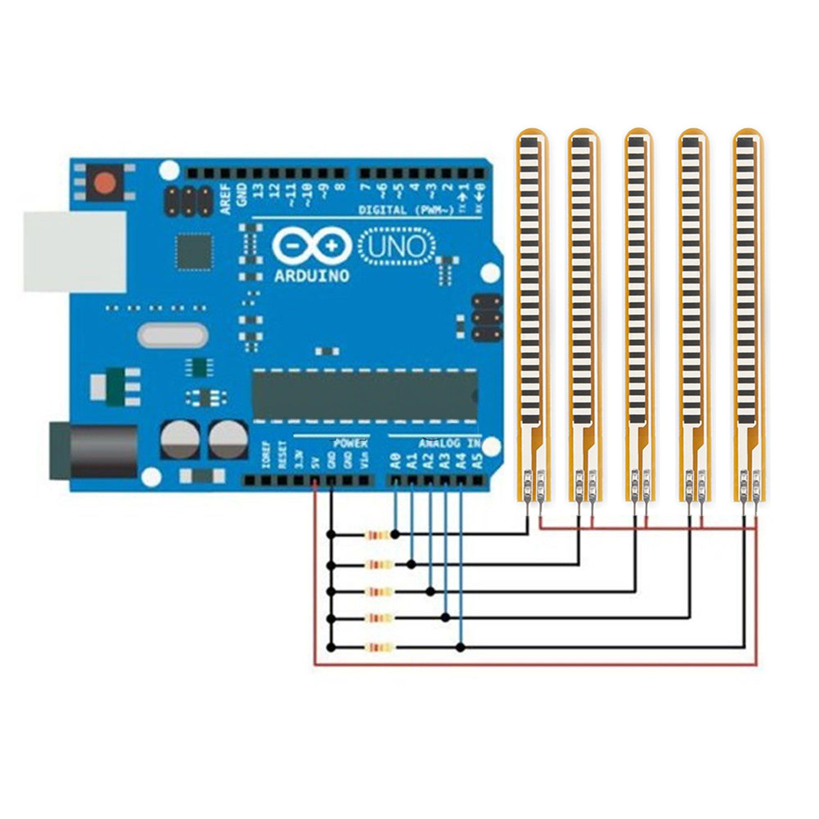
Hardware Setup 2
Connection between flex sensors and Arduino microcontroller:

Slide 6
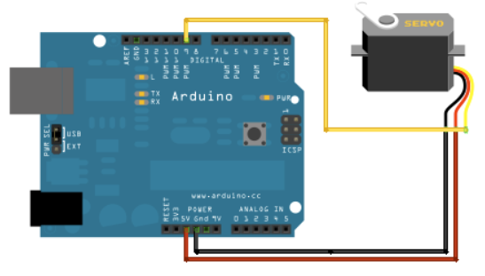
Hardware setup 2:
Connections between a Arduino microcontroller and Servo motor:

Slide 7
Step 1 : Getting the Data
Coding is done on the Arduino module so that it reads data from the bend sensors
The data is read from the flex sensors every 0.1s and then logged on the serial console
The Arduino module converts the input signal voltage (0V - 5V) to numbers ranging from 0 to 1023
The data of rock, paper, and scissors is stored in three different csv files
Notes:
priya

Slide 8
Step 2 : Visualizing the Data

Slide 9
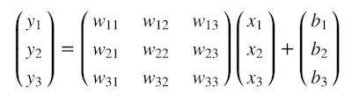
Step 3: Linearly Mapping 3D Data with TensorFlow
Significant to this project as it allows dynamic determination of dataset values (without need to hardcode ranges).
TensorFlow attempts to find the best weights and biases that will fit into the linear transformation by calculating them backward in the graph (training the model).
Formula when transforming 3D data into a linear representation:

Slide 10
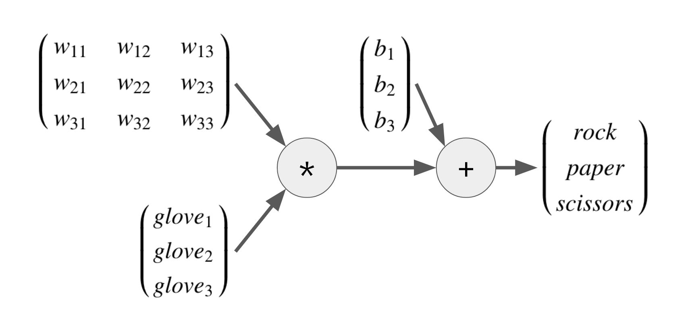
Step 3: Linearly Mapping 3D Data (cont.)
y = wx + B
3 x 3 weight matrix dynamically determined by Tensorflow algorithms.
1 x 3 glove matrix representation of data gathered by sensors. Represents the linear equations’ independent variable.
Bias dynamically determined by predicting any potential skewing present in dataset.

Slide 11
Step 4 : Training the Model
Define a “coach” for the training
Pass hundreds of labels (one-hot labels) for each glove sensor data
[ 1 0 0 ] for rock
[ 0 1 0 ] for paper
[ 0 0 1 ] for scissors
Define the loss function (how much error the model has) with a combination of softmax and cross entropy
Softmax: squish data into range of 0.0 to 1.0 -- estimated probabilities
Cross entropy: returns difference between one-hot labels and estimated probabilities
This function will create the “coach” for Tensorflow that will guide it to find the best parameters
Notes:
Step 7 Training the linear model requires a coach
will pass hundreds of labels for each glove sensor data where [1 0 0] represents rock, [0 1 0] is paper, and [0 0 1] is scissors.
define the loss function - the combination of softmax and cross entropy in this case
softmax squishes the numbers in rps_data into a range of 0.0 to 1.0 accordingly, so that we can use them as estimated probabilities for rock, paper and scissors.
cross entropy returns the difference between two probability distributions: the one-hot labels in rps_labels (the ground truth) and the estimated probabilities from the softmax.
loss function is a function that measures how much error the model has
This function will be the "coach" for TensorFlow that leads it in the right direction to find the best parameters

Slide 12
Step 4 : Training the Model (cont.)
Train the Linear Model
Run Tensorflow to train the model using an optimizer - Gradient Descent algorithm
To run the actual training:
create a Session
call run method to pass the glove sensor data and labels to the optimizer
call run method thousands of times
Result of training: good set of weights and biases that can map the glove sensor data into the rock paper scissors space with softmax probabilities
Notes:
Step 8 TensorFlow that uses Gradient Descent algorithm to modify the parameters so that it can minimize the error returned by the loss function.
To run the actual training, you need to create a Session and call its run method to pass the glove sensor data and labels to the optimizer.
Since the optimizer will change the parameter values little by little (at the specified learning rate), you need to call the method thousands of times.
After the training, you will have a good set of weights and biases that can map the glove sensor data into the rock-paper-scissors space with softmax probabilities.

Slide 13
Step 5 : Use Linear Model on Arduino
Weighted data from the linear model is fed into the Arduino
Then the linear model on the Arduino maps the glove sensor data into the rock paper and scissors space by doing matrix multiplication on the weights and biases
From the matrix multiplication we can get the highest value to predict whether it is rock paper or scissors
Depending on the prediction of the input, the Arduino will determine which output the servo should point to in order to win
Notes:
Archana
After we get a solid way to classify the the glove’s sensor data we have to make sure the Arduino is able to use the linear model we just trained
In order to do this we have to pass the trained data into the Arduino using weights
Then the linear model on the Arduino can map the glove sensor data into the rock-paper-scissors space
Then we can compute matrix multiplication between the data and the weights
Once we have the multiplication matrix, we can compare the values and find the highest one to determine the the hand posture
Once the hand posture is determined, the Servo can then control the machine hand to win the game.

Slide 14
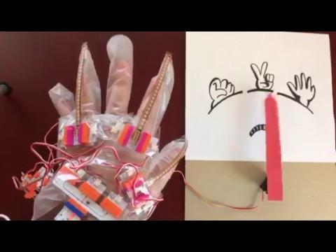

Slide 15
References
https://github.com/kazunori279/ml-misc/tree/master/glove-sensor
https://cloud.google.com/blog/products/gcp/my-summer-project-a-rock-paper-scissors-machine-built-on-tensorflow

Slide 16
Thank You

